Slide 1
Classifying Network Traffic Flow
Presented By :- Jay Riziya .

Slide 2
AGENDA
Introduction
Data Collection
Data Cleaning
Data Pre-processing
Exploratory Data Analysis (EDA)
Feature Engineering
Model Selection
Model Training

Slide 3
Introduction
Develop a robust machine learning model to accurately classify network traffic into normal and different types of attack categories based on various network flow features. By utilizing this model, the company aims to improve intrusion detection accuracy, reduce false positives, and enhance overall network security.
Improved Detection: The model will identify various types of network attacks, allowing for more effective intrusion detection.
Resource Optimization: By accurately classifying network traffic, the company can allocate security resources more efficiently.
Enhanced Security Posture: Understanding key factors influencing network attacks will help in developing more effective security strategies.

Slide 4
Data Collection
Load and explore the dataset using pandas, matplotlib, and seaborn.
Preprocess the data, including handling class imbalances and normalizing features.
Conduct feature selection to identify the most important network flow features.
Implement and compare multiple classification algorithms as base learners.
Generate and interpret performance metrics and visualizations for both individual models and the ensemble

Slide 5
Data Cleaning & Preprocesing
FUNCTION | OPERATIONS
df=pd.read_csv(“”) | Importing our dataset into Data frame and storing in df (i.evariable) (pd refers to pandas)
df.head(), df.tail() | To Display the first 5 Rows and last 5 Rows
df.shape() | array dimensions that tells the number of rows and columns of a given Data Frame.
df.info() | Display columns ,datatypes, non-null count and memory usage
df.describe() | Provides summary statistics of data like mean, median, minimum, maximum and more
df.isnull().sum() | Check the Total missing /null values
df.duplicated().sum() | Check the duplicate values

Slide 6
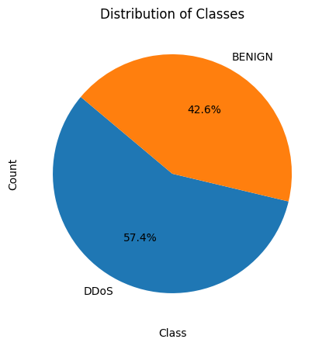
Exploratory Data Analysis
Count Plot of Label

Slide 7
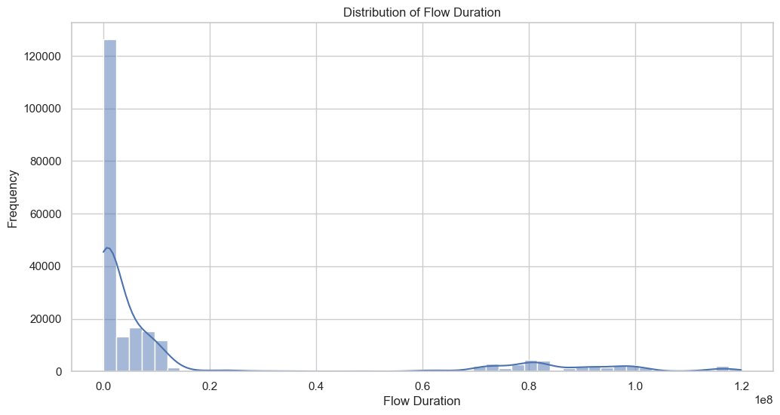
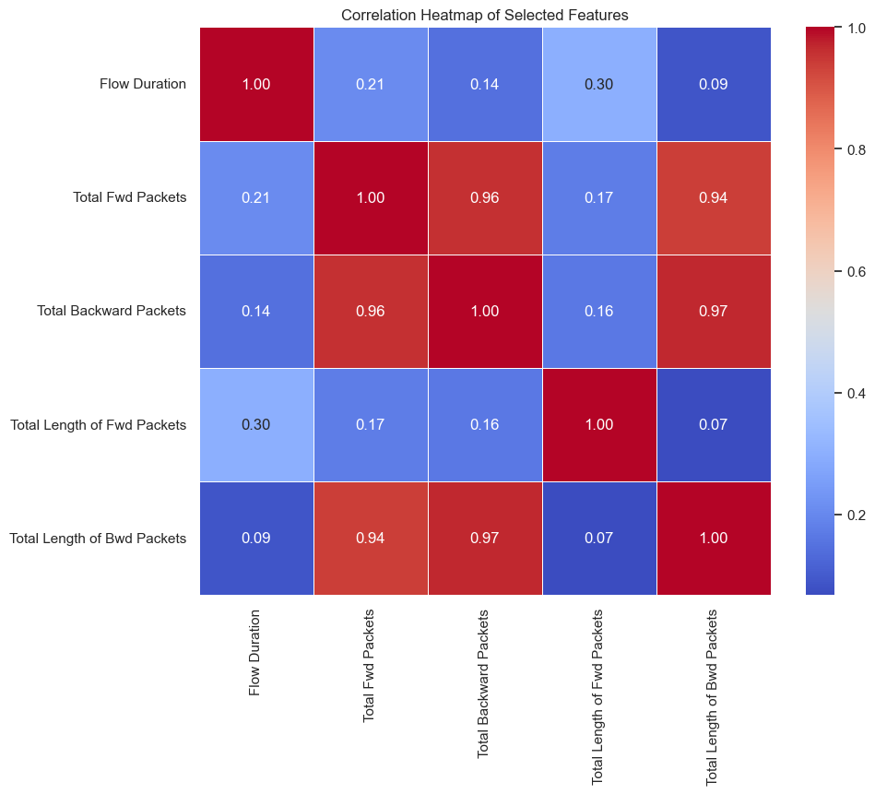
Data Visualization
Flow Duration Counts

Slide 8
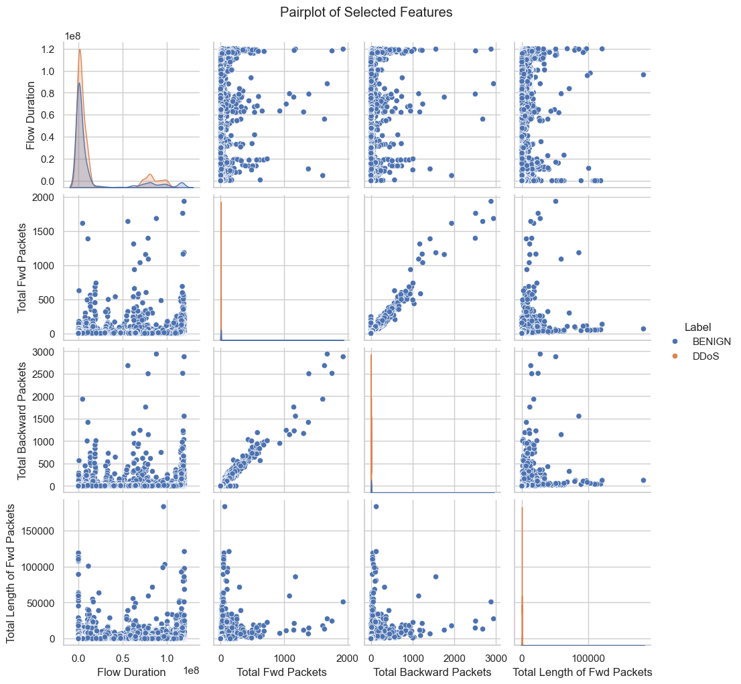
Data Visualization
Selected Features By Label

Slide 9
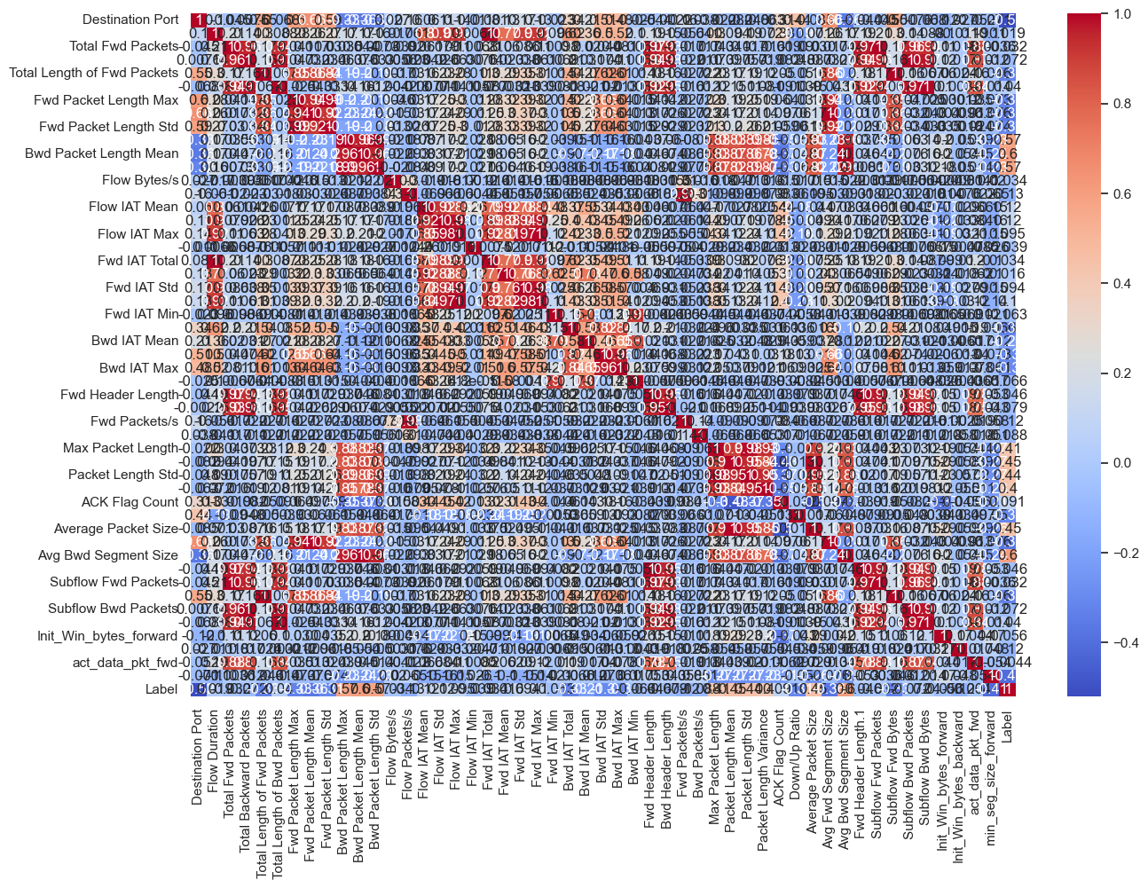
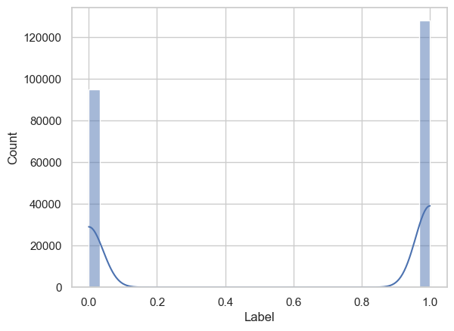
Data Visualization
plot of Label

Slide 10
Machine Learning
Encoding Categorical Features
Preparing Data for Modeling
encoder = LabelEncoder()
for column in columns_to_encode:
df[column] = encoder.fit_transform(df[column])
features = df.drop(columns=[‘Label'])
target = df[‘Label']

Slide 11
Splitting Data and Scaling Features
from sklearn.model_selection import train_test_split
from sklearn.preprocessing import StandardScaler, LabelEncoder
X_train, X_test, y_train, y_test = train_test_split(features, target, test_size=0.3, random_state=101)
scaler = StandardScaler()
X_train_scaled = scaler.fit_transform(X_train)
X_test_scaled = scaler.transform(X_test)

Slide 12
Results and Conclusion
MODEL | ACCURACY
Logistic Regression | 98.47 %
Random Forest Classifier | 99.99 %
SVC | 98.85 %
Extra Tree Classifier | 99.97 %
Decision Tree Classifier | 99.98%
Ada Boost Classifier | 99.99%
XGB Classifier | 100.00%

Slide 13
Thank You !
Jay Riziya

